Slide 1

WebSite-Presentation The Precise Range (e-commerce)
Submitted by: ROHIT DABAS
BCA-B, 1ST SAM
ROLL. NO. 229071

Slide 2

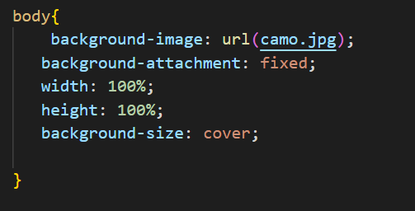
website Section:TOP
BODY
<---IMG
CSS---->

Slide 3

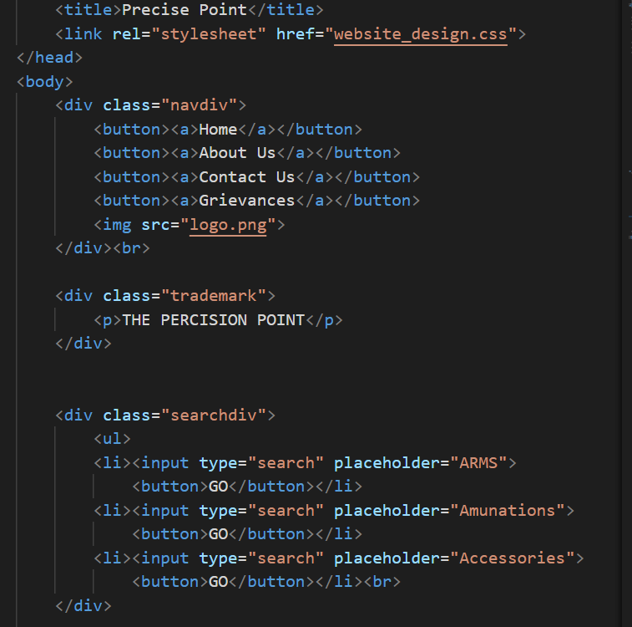
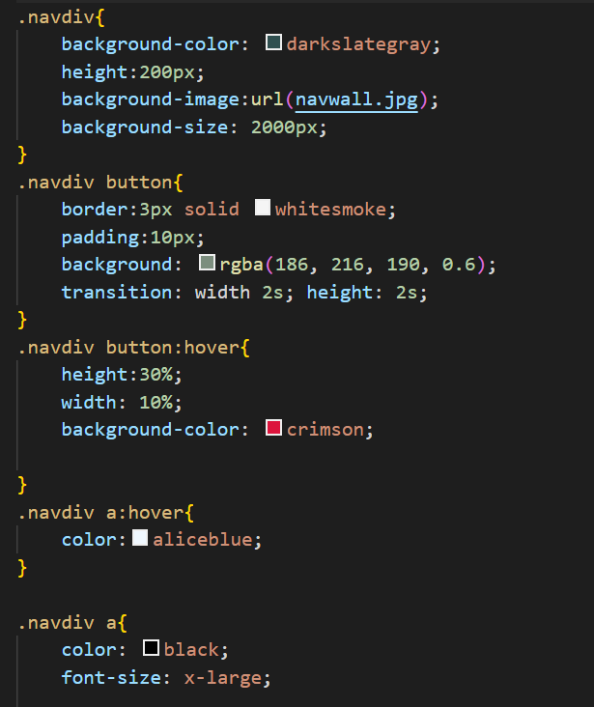
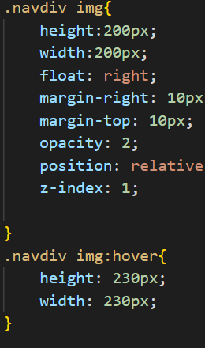
website Section:TOP
Navigation bar,Logo,Search Bars,Nav bg
<---HTML
CSS---->

Slide 4
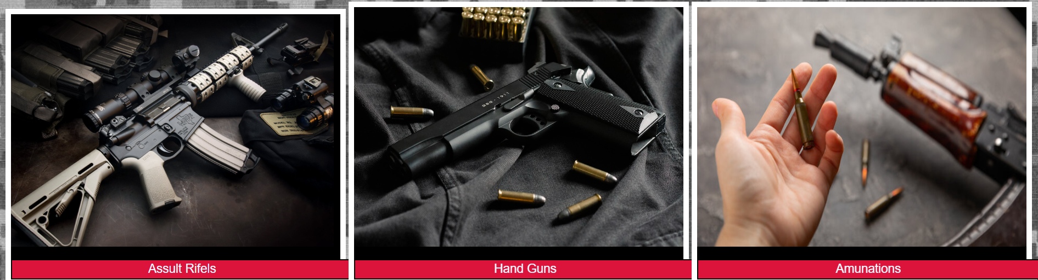
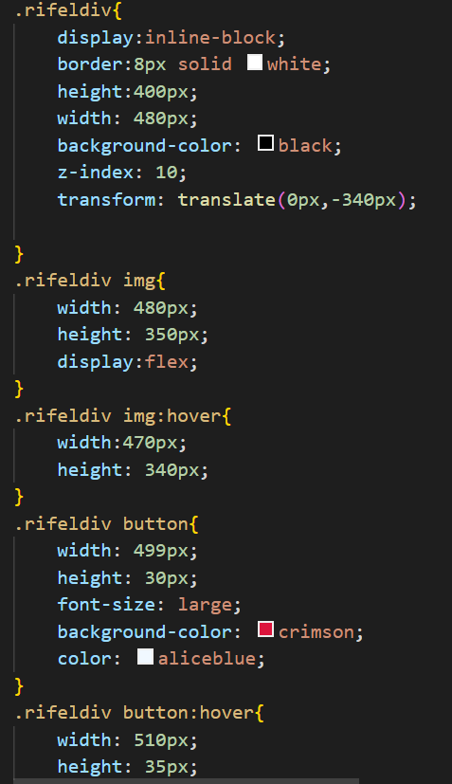
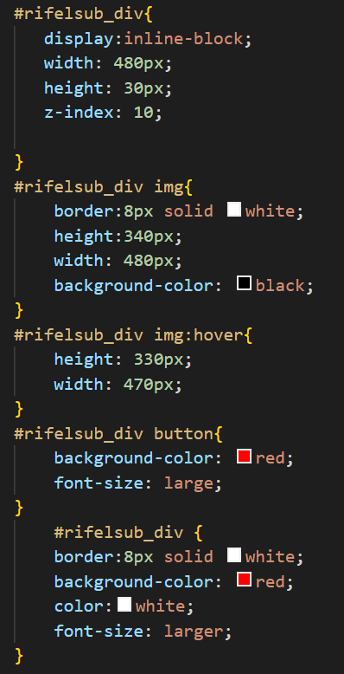
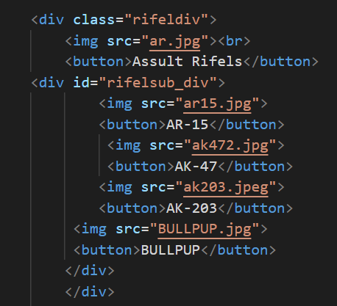
website Section:MID
Image div,Buttons,Transition
<---HTML
CSS--->

Slide 5
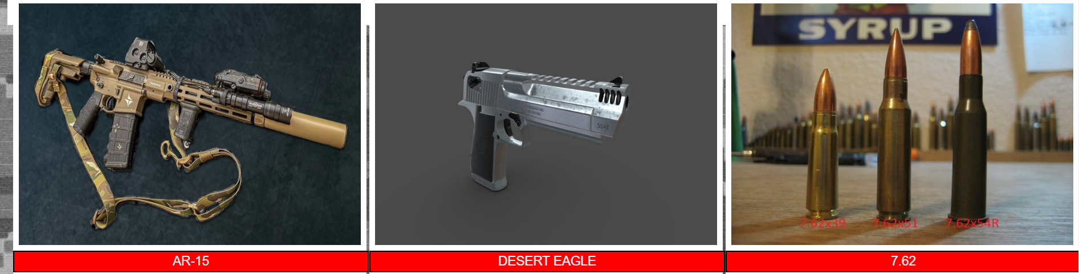
website Section:MID
Image div,Button & Transition

Slide 6
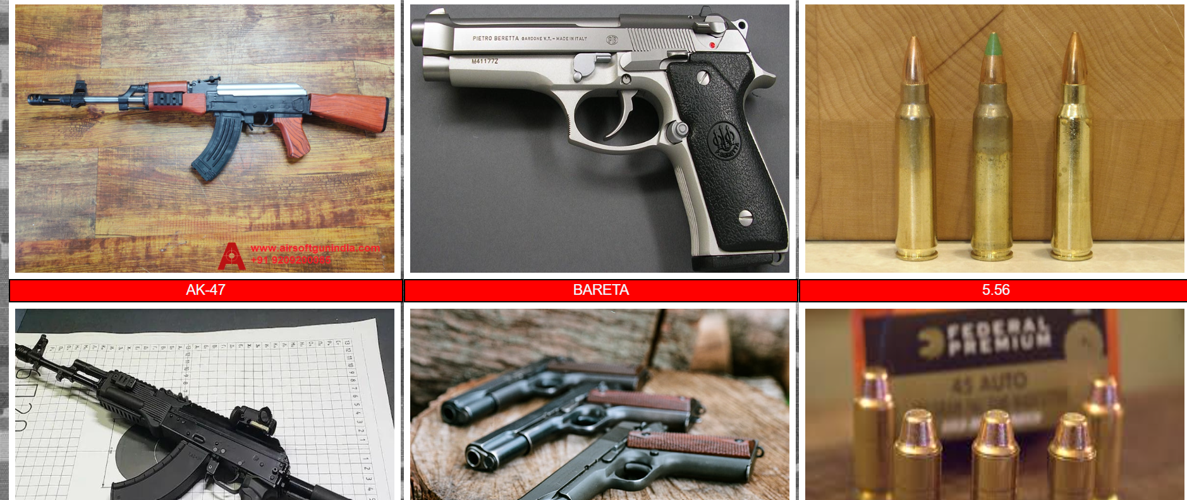
website Section:MID
Image div,Button & Transition

Slide 7
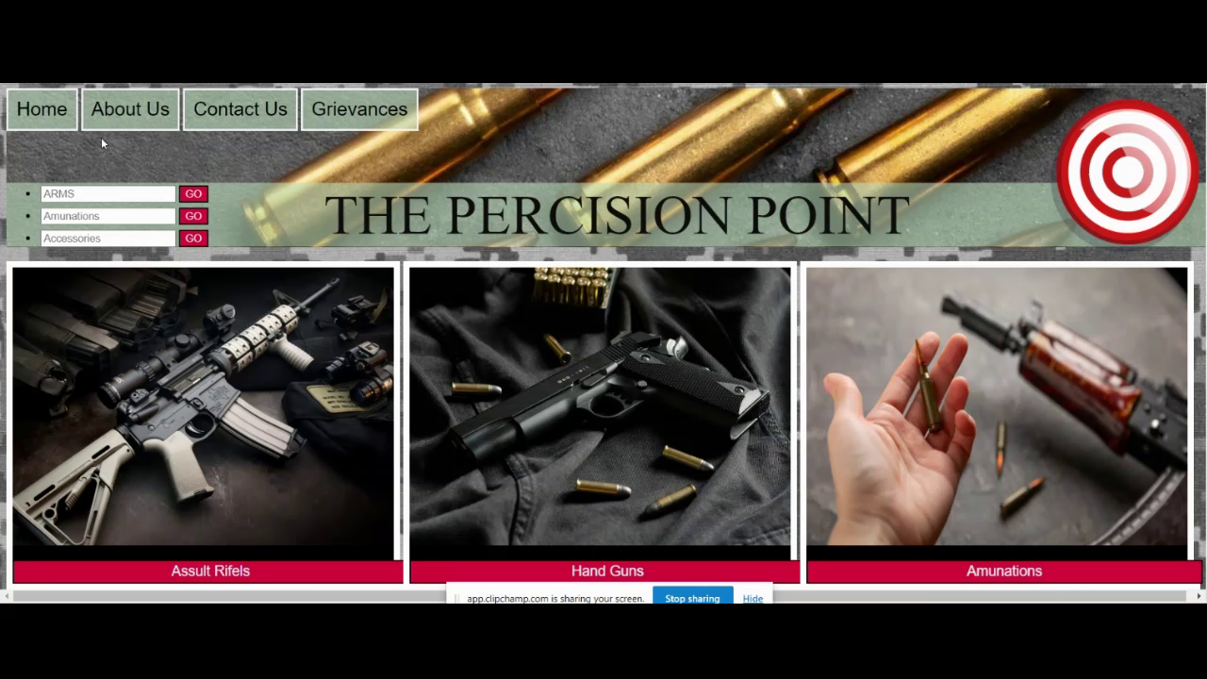
website Section:MID preview

Slide 8
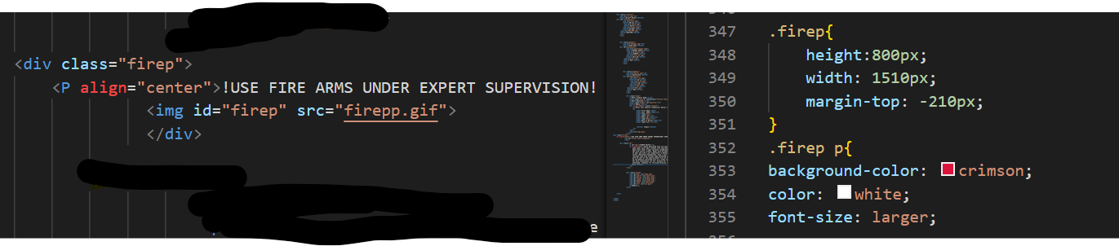
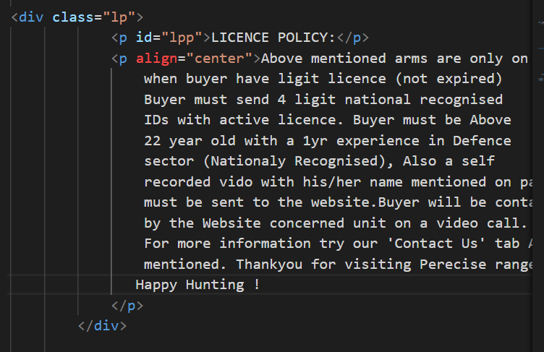
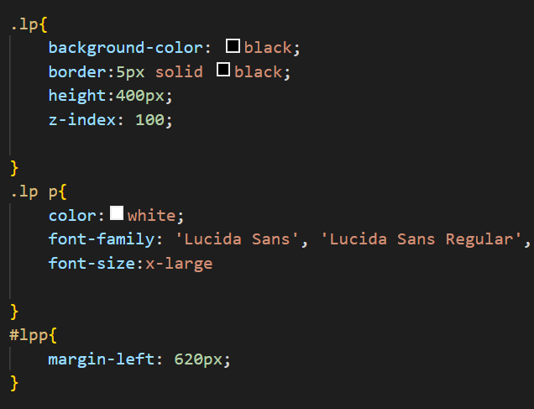
website Section:LOW
z-index function, font size function,gif extention

Slide 9

website Section:LOW MID
gif extention

Slide 10

website Section:LOW
Input types

Slide 11
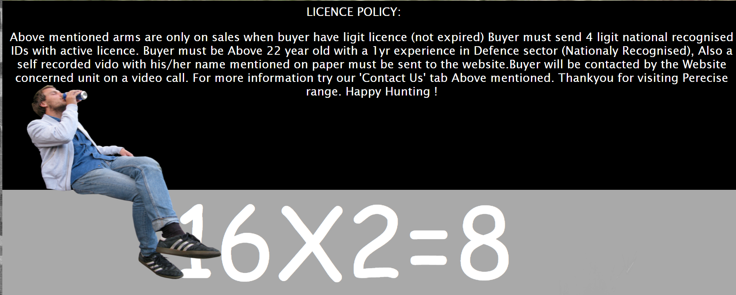
website Section:LOW

Slide 12
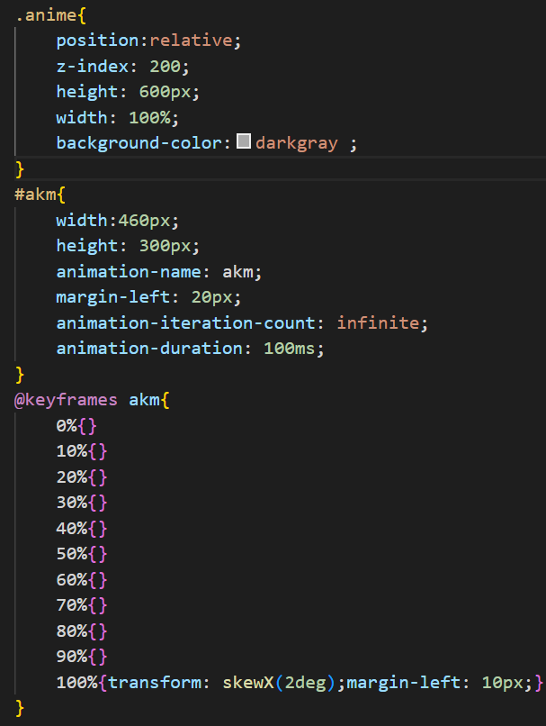

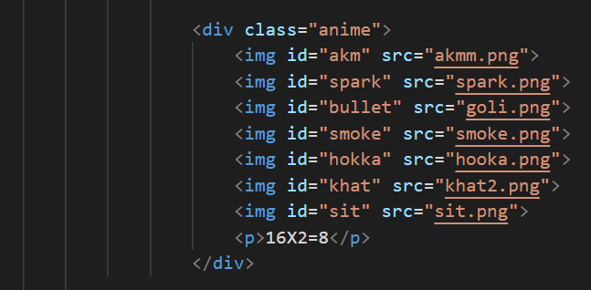
website Section:BOTTOM
Animation property
<---IMG
CSS---->

Slide 13
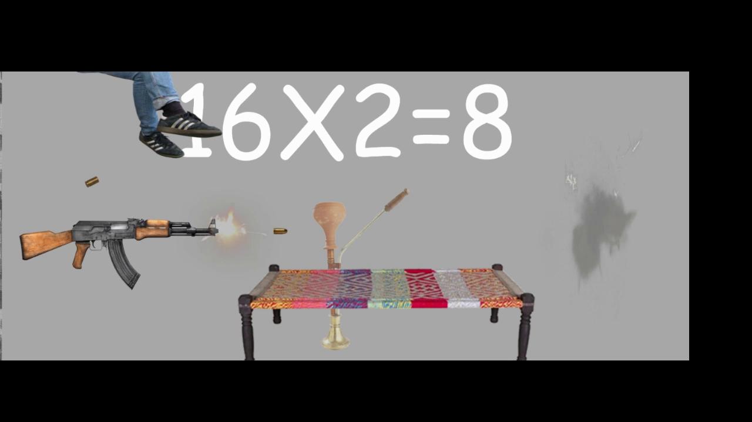
website Section:BOTTOM preview

Slide 14
THANKS FOR WATCHING

